Slide 2
10:1-33
Examples/Idolatry/Consciences

Slide 3
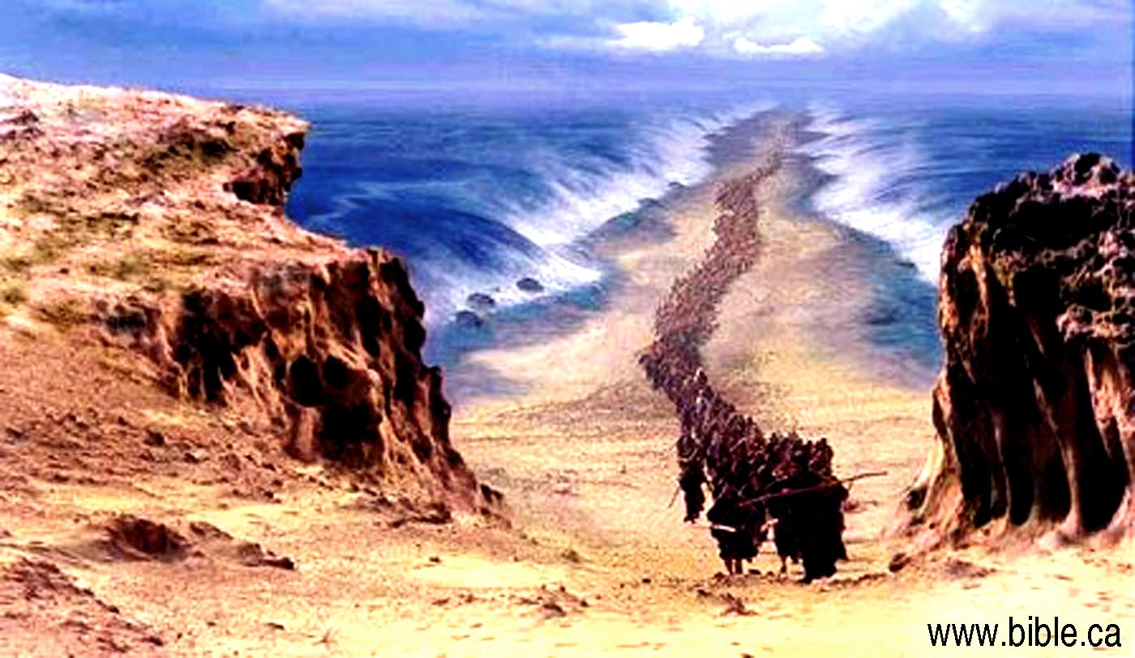
1 Corinthians 10 - Overview
Paul will bring to conclusion his discussion concerning meat offered to idols.
Using Israel as an example, Paul commands them to "flee idolatry”. (1-14)
Warns against provoking the Lord to jealousy by having fellowship with demons. (15-22)
Once again addresses meat later sold in the market place and served at the home of an unbeliever. (23-30)
Do all to the glory of God, and provide no occasion for others to stumble, just as Paul did. (31-33)

Slide 4
1 Corinthians 10 – Overview
Matters of Liberty – When to say “NO”
If partaking would cause a weaker brother to stumble.
1 Cor. 8:13
If an action could hinder the cause of the gospel.
1 Cor. 9:12
Do not attempt to live close to sin.
1 Cor. 10:12
Will it glorify God?
1 Cor. 10:31

Slide 5
1 Cor. 10:1-14 Moreover, brethren, I do not want you to be unaware that all our fathers were under the cloud, all passed through the sea, 2 all were baptized into Moses in the cloud and in the sea, 3 all ate the same spiritual food, 4 and all drank the same spiritual drink. For they drank of that spiritual Rock that followed them, and that Rock was Christ. 5 But with most of them God was not well pleased, for their bodies were scattered in the wilderness. 6 Now these things became our examples, to the intent that we should not lust after evil things as they also lusted. 7 And do not become idolaters as were some of them. As it is written, “The people sat down to eat and drink, and rose up to play.” 8 Nor let us commit sexual immorality, as some of them did, and in one day twenty-three thousand fell; 9 nor let us tempt Christ, as some of them also tempted, and were destroyed by serpents; 10 nor complain, as some of them also complained, and were destroyed by the destroyer. 11 Now all these things happened to them as examples, and they were written for our admonition, upon whom the ends of the ages have come. 12 Therefore let him who thinks he stands take heed lest he fall. 13 No temptation has overtaken you except such as is common to man; but God is faithful, who will not allow you to be tempted beyond what you are able, but with the temptation will also make the way of escape, that you may be able to bear it. 14 Therefore, my beloved, flee from idolatry.

Slide 6
In what sense were the Israelites baptized into Moses? (vs. 2)
Exodus 14:21-22
Israel crossed the Red Sea on dry land
The waters on either side and the cloud overshadowing them
Israel was delivered from Egypt’s bondage by God’s grace through their faith (Heb. 11:29)
Made them disciples of Moses
Obligated to recognize his divine commission and submit to his authority
Just as Christians are separated from bondage of sin and brought under authority of Jesus through baptism. (Rom 6:3-5; Gal 3:26-27)

Slide 7
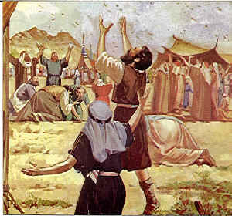
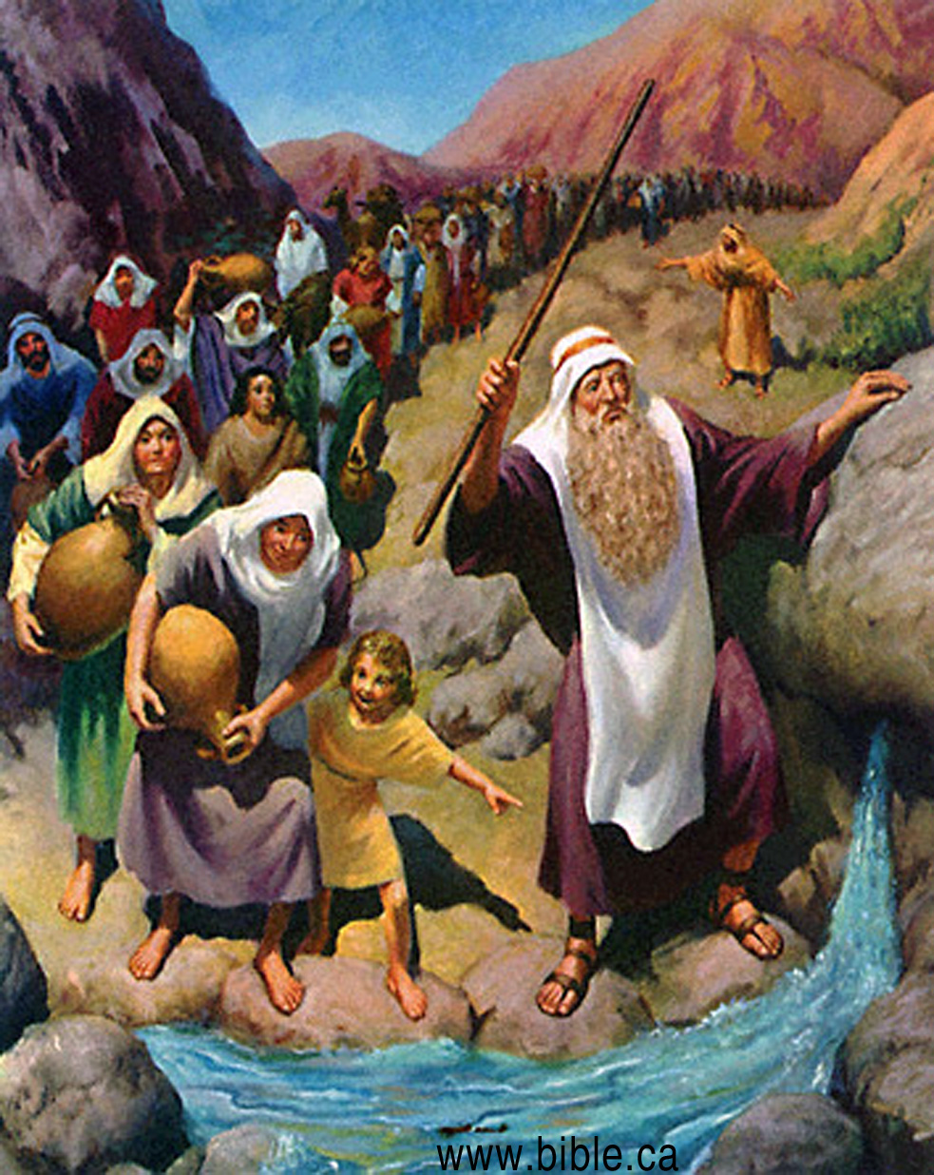
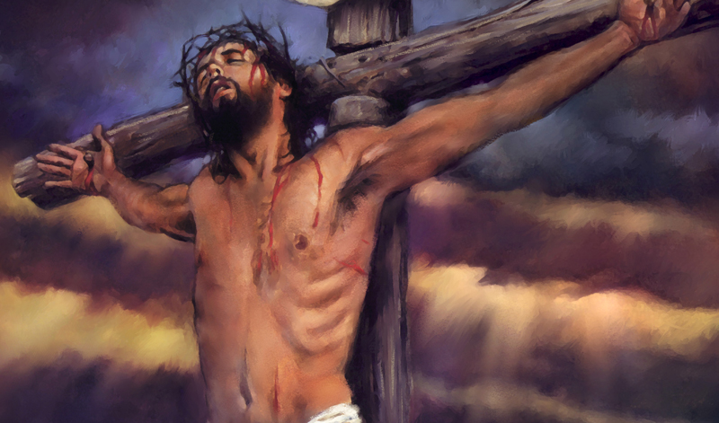
2. What point is Paul trying to make by using Israel? (vs. 6)
Exodus 16:2-4 2 Then the whole congregation of the children of Israel complained against Moses and Aaron in the wilderness. 3 And the children of Israel said to them, “Oh, that we had died by the hand of the Lord in the land of Egypt, when we sat by the pots of meat and when we ate bread to the full! For you have brought us out into this wilderness to kill this whole assembly with hunger.” 4 Then the Lord said to Moses, “Behold, I will rain bread from heaven for you. And the people shall go out and gather a certain quota every day, that I may test them, whether they will walk in My law or not.
Exodus 17:5-6 And the Lord said to Moses, “Go on before the people, and take with you some of the elders of Israel. Also take in your hand your rod with which you struck the river, and go 6 Behold, I will stand before you there on the rock in Horeb; and you shall strike the rock, and water will come out of it, that the people may drink.”And Moses did so in the sight of the elders of Israel.
John 6:31-35 31 Our fathers ate the manna in the desert; as it is written, ‘He gave them bread from heaven to eat.’”
32 Then Jesus said to them, “Most assuredly, I say to you, Moses did not give you the bread from heaven, but My Father gives you the true bread from heaven. 33 For the bread of God is He who comes down from heaven and gives life to the world.” 34 Then they said to Him, “Lord, give us this bread always.” 35 And Jesus said to them, “I am the bread of life. He who comes to Me shall never hunger, and he who believes in Me shall never thirst.
Paul drawing a parallel
Heb 3:16-19 For who, having heard, rebelled? Indeed, was it not all who came out of Egypt, led by Moses? 17 Now with whom was He angry forty years? Was it not with those who sinned, whose corpses fell in the wilderness? 18 And to whom did He swear that they would not enter His rest, but to those who did not obey? 19 So we see that they could not enter in because of unbelief.
Israel
church at Corinth
Freed from Egypt’s bondage by grace of God
Freed from bondage of sin by grace of God
“All” partook of spiritual food and drink
“All” partake of spiritual food and drink
Many did not enter the Promised Land because of their sin. (Heb 3:16-19)
Many will be lost if they do not repent of their sins.

Slide 8
3. Read Numbers 21:4-9 and explain how it is possible to tempt Christ.
Matt 7:21-23 “Not everyone who says to Me, ‘Lord, Lord,’ shall enter the kingdom of heaven, but he who does the will of My Father in heaven. 22 Many will say to Me in that day, ‘Lord, Lord, have we not prophesied in Your name, cast out demons in Your name, and done many wonders in Your name?’ 23 And then I will declare to them, ‘I never knew you; depart from Me, you who practice lawlessness!’
To tempt Christ means to try His patience
The Israelites tried His patience with their
Rebellion
Murmuring
Impatience
The church at Corinth tried His patience when
Exposing themselves to temptations in idol temples
Taking God’s grace for granted

Slide 9
4. According to Paul, what benefit is there to reading the Old Testament?
Examples
How God deals with man
Our admonition
Instruction
Correction
Exhortation
Warning
Deut 11:16-21; 2 Tim 2:15; 2 Tim 3:14-17

Slide 10
1 Cor. 10:12 Therefore let him who thinks he stands take heed lest he fall.
Heb 3:12-14 Beware, brethren, lest there be in any of you an evil heart of unbelief in departing from the living God; 13 but exhort one another daily, while it is called “Today,” lest any of you be hardened through the deceitfulness of sin. 14 For we have become partakers of Christ if we hold the beginning of our confidence steadfast to the end,
What fact is Paul stating?
Christians can fall from grace
Some at Corinth who thought they were strong enough to eat meats sacrificed to idols in the idol temples without committing sin

Slide 11
According to verse 13, list five key points that make it possible for us not to give into temptations:
All temptations are common to man
God is faithful
Not tempted beyond what we can control
Will provide a way of escape
We can bare it
1 Cor. 10:14 Therefore, my beloved, flee from idolatry.

Slide 12
1 Cor. 10:15-33 I speak as to wise men; judge for yourselves what I say. 16 The cup of blessing which we bless, is it not the communion of the blood of Christ? The bread which we break, is it not the communion of the body of Christ? 17 For we, though many, are one bread and one body; for we all partake of that one bread. 18 Observe Israel after the flesh: Are not those who eat of the sacrifices partakers of the altar? 19 What am I saying then? That an idol is anything, or what is offered to idols is anything? 20 Rather, that the things which the Gentiles sacrifice they sacrifice to demons and not to God, and I do not want you to have fellowship with demons. 21 You cannot drink the cup of the Lord and the cup of demons; you cannot partake of the Lord’s table and of the table of demons. 22 Or do we provoke the Lord to jealousy? Are we stronger than He? 23 All things are lawful for me,[a] but not all things are helpful; all things are lawful for me, but not all things edify. 24 Let no one seek his own, but each one the other’s well-being. 25 Eat whatever is sold in the meat market, asking no questions for conscience’ sake; 26 for “the earth is the Lord’s, and all its fullness.” 27 If any of those who do not believe invites you to dinner, and you desire to go, eat whatever is set before you, asking no question for conscience’ sake. 28 But if anyone says to you, “This was offered to idols,” do not eat it for the sake of the one who told you, and for conscience’ sake;[d] for “the earth is the Lord’s, and all its fullness.” 29 “Conscience,” I say, not your own, but that of the other. For why is my liberty judged by another man’s conscience? 30 But if I partake with thanks, why am I evil spoken of for the food over which I give thanks? 31 Therefore, whether you eat or drink, or whatever you do, do all to the glory of God. 32 Give no offense, either to the Jews or to the Greeks or to the church of God, 33 just as I also please all men in all things, not seeking my own profit, but the profit of many, that they may be saved.

Slide 13
What does Paul say is the cup of blessing?
Fruit of the vine
What is Paul pointing out in verse 17 when stating, “For we, though many, are one bread and one body”?
Christians at Corinth could not partake of the meat offered to idols in the idol temples without giving the appearance they approved.

Slide 14
Was it okay for a Christian to accept an invitation to dinner in a non believer’s home if meat served to an idol was being served?
Yes, but if it was pointed out that the meat had been offered to an idol then do not participate. (vs. 27-28)
Why?
Should not be seen as endorsing worship of idols. (vs. 28)

Slide 15
7. Who do the Gentiles choose to offer sacrifices to instead of God?
Demons rather than God

Slide 16
8. What points does Paul make concerning a Christian’s participation in the eating of meat offered to idols?
Don’t partake if it may cause a weaker brother to stumble. 1 Cor. 8:13
Do not attempt to live close to sin.
1 Cor. 10:12
Don’t partake if it may hinder the cause of the gospel.
1 Cor. 9:12
Will it glorify God?
1 Cor. 10:31

Slide 17
9. What prevents someone from considering others before themselves?
1 Cor 8:1
Love edifies

Slide 18
10. Explain what Paul is teaching in vs. 31.
Do all to the glory of God
1 Peter 2:12 Having your conversation honest among the Gentiles: that, whereas they speak against you as evildoers, they may by your good works, which they shall behold, glorify God in the day of visitation.
1 Corinthians 6:20 For ye are bought with a price: therefore glorify God in your body, and in your spirit, which are God's.
Matthew 5:16 Let your light so shine before men, that they may see your good works, and glorify your Father which is in heaven.

