Slide 1
1 Corinthians 9:1-27
Paul’s Self Denial

Slide 2
Chapter 9 - Breakdown
Vs. 1-14 “The right to be supported”
Vs. 15-18 “Paul’s self denial”
Vs. 19-23 “Becoming all things to all men”
Vs. 24-27 “Self-denial is for the crown”

Slide 3
What is an apostle?
Each of the 12 chief disciples of Jesus Christ.
Jesus’ authorized agents or representatives.
One specially commissioned by Christ.

Slide 4
Paul an Apostle?
1 Timothy 1:1, Galatians 1:1
Acts 9:1-9, 22:6-16, 26:12-18
Acts 1:21-22

Slide 5
Questioning Paul’s Apostleship
2 Corinthians 12:11-12
Galatians 1:15-24
Hebrews 2:1-4
1 John 4:1

Slide 6
Lacking Knowledge?
1 Cor. 9:14
Lev. 7:33
Matthew 10:10
1 Tim. 5:18

Slide 7
Paul’s Income
Tentmaker
Acts 18:3
Outside Support
2 Cor. 11:8
“I kept myself from being a burden to you.”

Slide 8
Paul “Under Compulsion”
Acts 9:15 But the Lord said to him, “Go, for he is a chosen vessel of Mine to bear My name before Gentiles, kings, and the children of Israel.”
Jeremiah 20:9 His word was in my heart like a burning fire Shut up in my bones; I was weary of holding it back And I could not.
Colossians 3:16 Let the word of Christ richly dwell within you.

Slide 9
Becoming All Things to All Men
Those under the law
Acts 16:3
Those without the law
1 Timothy 1:15
Those who are weak
1 Cor. 8:9-12
All Things to All Men

Slide 10
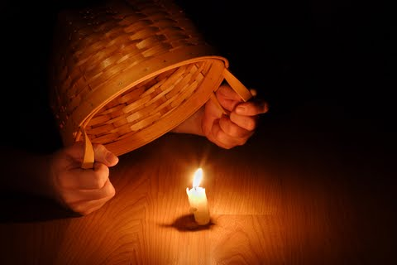
Hide it Under a Bushel?
NO!
Colossians 3:17

Slide 11
Run in such a way that you may win.
Exercise self-control in all things.
As not without aim.
I discipline my body and make it my slave.
I myself will not be disqualified.
Philippians 3:14

