Slide 2
8:1-13
Use Your Liberty Wisely

Slide 3
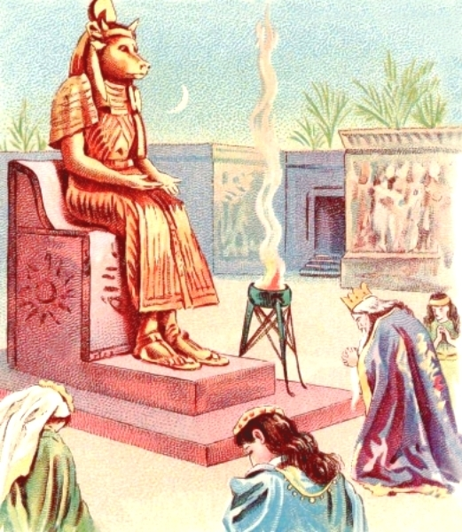
Background
Eating of meats sacrificed to pagan idols
Pagan sacrifices did not consume all of the meat
Portion given to the priest
Participant in the sacrifice given remainder
Meat used for a feast in one’s home or idol’s temple
Priests might sell some of the meat in the local market

Slide 4
The question arose in Corinth:
Can a Christian eat meat that had been sacrificed to an idol?
Christians coming from a pagan background might struggle with the idea of eating meat which had been sacrificed to an idol.
For these Christians it would be wrong for them to eat because doing so would violate their conscience.
Since idols represent gods which don’t actually exist, eating food which had previously been offered to them is not a sin.

Slide 5
Paul’s focus:
Less on what Christians can and can’t do
More on teaching the stronger and weaker brothers how to interact with one another.
They should treat one another with “love”
The stronger brother should be willing to give up meat forever in order to avoid leading his weaker brother to sin against his conscience
The weaker brother shouldn’t try to bind his stronger brother’s actions by his own conscience.

Slide 6
1 Corinthians 8:1-13 Now concerning things offered to idols: We know that we all have knowledge. Knowledge puffs up, but love edifies. 2 And if anyone thinks that he knows anything, he knows nothing yet as he ought to know. 3 But if anyone loves God, this one is known by Him. 4 Therefore concerning the eating of things offered to idols, we know that an idol is nothing in the world, and that there is no other God but one. 5 For even if there are so-called gods, whether in heaven or on earth (as there are many gods and many lords), 6 yet for us there is one God, the Father, of whom are all things, and we for Him; and one Lord Jesus Christ, through whom are all things, and through whom we live. 7 However, there is not in everyone that knowledge; for some, with consciousness of the idol, until now eat it as a thing offered to an idol; and their conscience, being weak, is defiled. 8 But food does not commend us to God; for neither if we eat are we the better, nor if we do not eat are we the worse. 9 But beware lest somehow this liberty of yours become a stumbling block to those who are weak. 10 For if anyone sees you who have knowledge eating in an idol’s temple, will not the conscience of him who is weak be emboldened to eat those things offered to idols? 11 And because of your knowledge shall the weak brother perish, for whom Christ died? 12 But when you thus sin against the brethren, and wound their weak conscience, you sin against Christ. 13 Therefore, if food makes my brother stumble, I will never again eat meat, lest I make my brother stumble.

Slide 7
Describe the difference in how someone is impacted by knowledge vs love? (vs. 1)
1 John 4:20-21 If someone says, “I love God,” and hates his brother, he is a liar; for he who does not love his brother whom he has seen, how can[a] he love God whom he has not seen? 21 And this commandment we have from Him: that he who loves God must love his brother also.
1 Cor. 13:2 And though I have the gift of prophecy, and understand all mysteries and all knowledge, and though I have all faith, so that I could remove mountains, but have not love, I am nothing.
2 Timothy 2:15 Be diligent to present yourself approved to God, a worker who does not need to be ashamed, rightly dividing the word of truth.
Romans 14:19 Therefore let us pursue the things which make for peace and the things by which one may edify another.
Knowledge puffs up
Proverbs 1:7 The fear of the LORD is the beginning of knowledge; fools despise wisdom and instruction.
Is Paul stating that knowledge is bad and something to be avoided?
Love edifies

Slide 8
2. What does a Christian understand about God? (vs. 4)
There is no other God but one
Deut 4:35 To you it was shown, that you might know that the Lord Himself is God; there is none other besides Him.
Isaiah 46:9 Remember the former things of old, For I am God, and there is no other; I am God, and there is none like Me,
1 Tim 2:5 For there is one God and one Mediator between God and men, the Man Christ Jesus,
Eph 4:4-6 There is one body and one Spirit, just as you were called in one hope of your calling; one Lord, one faith, one baptism; one God and Father of all, who is above all, and through all, and in you all.

Slide 9
3. What is an idol and why did they come into existence? (vs. 4)
An idol is nothing
Leviticus 26:1 ‘You shall not make idols for yourselves; neither a carved image nor a sacred pillar shall you rear up for yourselves; nor shall you set up an engraved stone in your land, to bow down to it; for I am the Lord your God.

Slide 10
4. What knowledge does a Christian have that would allow the eating of meats sacrificed to idols?
Acts 17:24-25 “God, who made the world and everything in it, since He is Lord of heaven and earth, does not dwell in temples made with hands. Nor is He worshiped with men’s hands, as though He needed anything, since He gives to all life, breath, and all things.
Col 1:16 For by Him all things were created that are in heaven and that are on earth, visible and invisible, whether thrones or dominions or principalities or powers. All things were created through Him and for Him.
There is one God
The Father of whom are all things
The Lord Jesus Christ through whom are all things

Slide 11
5. What historical facts about the city of Corinth would make it necessary for Paul to address the eating of meats offered to idols?
4th largest city in Roman Empire
Wealthy and prosperous
Important trade route
Many different nationalities and cultures
12 pagan temples in Corinth

Slide 12
6. In verse 6, Paul describes God as “the Father, of whom are all things” and Jesus as “through whom are all things, and through whom we live”. What is Paul teaching about God and Jesus?
There is one God
The Father of whom are all things
The Lord Jesus Christ through whom are all things

Slide 13
7. In verse 7, is Paul stating some Christians are more prone to stumble and sin when making reference to “being weak”?
No
Have not fully matured spiritually
In this case, does not yet fully understand pagan idols
Therefore, when eating meat offered to idols, they think they are sinning
Rom 14:23 But he who doubts is condemned if he eats, because he does not eat from faith; for whatever is not from faith is sin.

Slide 14
8. What is Paul stating should be considered when a Christian is deciding whether to carry out an action or not?
Rom 14:13-17 13 Therefore let us not judge one another anymore, but rather resolve this, not to put a stumbling block or a cause to fall in our brother’s way.
14 I know and am convinced by the Lord Jesus that there is nothing unclean of itself; but to him who considers anything to be unclean, to him it is unclean. 15 Yet if your brother is grieved because of your food, you are no longer walking in love. Do not destroy with your food the one for whom Christ died. 16 Therefore do not let your good be spoken of as evil; 17 for the kingdom of God is not eating and drinking, but righteousness and peace and joy in the Holy Spirit.
8 But food does not commend us to God; for neither if we eat are we the better, nor if we do not eat are we the worse.
9 But beware lest somehow this liberty of yours become a stumbling block to those who are weak.
1 Cor 10:32 Give no offense, either to the Jews or to the Greeks or to the church of God,

Slide 15
9. Explain how it is possible for something to be sinful for one person but not for another person.
Rom 14:23 But he who doubts is condemned if he eats, because he does not eat from faith; for whatever is not from faith is sin.

Slide 16
10. How can you tell if a Christian lacks the love of God that edifies?
They have no regard for the weakness of others
Their actions become a stumbling block to those that are weak
Not only do they sin against their brother but they also sin against Christ

Slide 17
11. What doctrine does verse 11 refute?
11 And because of your knowledge shall the weak brother perish, for whom Christ died?
Once saved, always saved

Slide 18
12. When would a Christian not allow a weaker brother’s lack of knowledge to prevent them from doing something?
When it would cause them not to obey God
2 John 9 Whoever transgresses and does not abide in the doctrine of Christ does not have God. He who abides in the doctrine of Christ has both the Father and the Son.

Slide 19
Key Application from today’s Lesson
I will do all that is possible, within the will of God, not to become a stumbling block to another Christian by causing them to violate their conscience.

