Slide 2
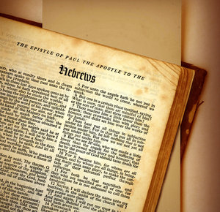
Heb 12:1
Therefore, since we are surrounded by so great a cloud of witnesses, let us also lay aside every weight, and
sin which clings so closely, and let us run with endurance the race that is set before us,

Slide 3
RUNNING THE RIGHT RACE
FOR A REAL REWARD

Slide 4
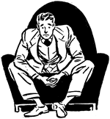
I. We Must Lay Aside Every Weight.
A. Worrying Too Much.
Failing health
Future
Job security
Children
Finances
Neighborhood violence
Aging parents
World terrorism

Slide 5
I. We Must Lay Aside Every Weight.
Matthew 6:25-34
1. Worrying ignores the logic of life (v. 25)
2. Worrying ignores the value of life (v. 26)
3. Worrying ignores its own limitations (v. 27)
4. Worrying ignores God's faithfulness (vv. 28-30)
5. Worrying ignores the love of God (vv. 31-33)
6. Worrying ignores the present (v. 34)

Slide 6
I. We Must Lay Aside Every Weight.
Worrying Too Much.
Working Too Much.
2 Thess 3:10
For even when we were with you, this we commanded you, that if any would not work, neither should he eat.

Slide 7
I. We Must Lay Aside Every Weight.
Worrying Too Much.
Working Too Much.
1 Tim 5:8
But if any provide not for his own, and specially for those of his own house, he hath denied the faith, and is worse than an infidel.

Slide 8
I. We Must Lay Aside Every Weight.
Worrying Too Much.
Working Too Much.
Isa 44:28
That saith of Cyrus, He is my shepherd, and shall perform all my pleasure: even saying to Jerusalem, Thou shalt be built; and to the temple, Thy foundation shall be laid.

Slide 9
I. We Must Lay Aside Every Weight.
Worrying Too Much.
Working Too Much.
Whining Too Much

Slide 10
I. We Must Lay Aside Every Weight.
Heb 12:1
Therefore, since we are surrounded by so great a cloud of witnesses, let us also lay aside every weight, and sin which clings so closely…

Slide 11
I. We Must Lay Aside Every Weight.
II. We Must Run with Endurance.
ENDURANCE
“the characteristic of a man who is unswerved from his deliberate purpose and his loyalty to faith and piety by even the greatest trials and sufferings” (Thayer's Greek Lexicon).

Slide 12
I. We Must Lay Aside Every Weight.
II. We Must Run with Endurance.
ENDURANCE
“the characteristic of a man who is unswerved from his deliberate purpose and his loyalty to faith and piety by even the greatest trials and sufferings” (Thayer's Greek Lexicon).
“CHEERFUL ENDURANCE” (Strong)

Slide 13
I. We Must Lay Aside Every Weight.
II. We Must Run with Endurance.
William Barclay:
“Hupomone is not simply the ability to bear things; it is the ability to turn them to greatness and to glory. The thing which amazed the heathen in the centuries of persecution was that the martyrs did not die grimly, they died singing.”

Slide 14
RUNNING THE RIGHT RACE
I. We Must Lay Aside Every Weight.
II. We Must Run with Endurance.
III. We Must Run the Race.

Slide 15
I. We Must Lay Aside Every Weight.
II. We Must Run with Endurance.
III. We Must Run the Race.

Slide 16
I. We Must Lay Aside Every Weight.
II. We Must Run with Endurance.
III. We Must Run the Race.

