Slide 2
Philippians 4:4-9
⁴ Rejoice in the Lord always. Again I will say, rejoice! ⁵ Let your gentleness be known to all men. The Lord is at hand. ⁶ Be anxious for nothing, but in everything by prayer and supplication, with thanksgiving, let your requests be made known to God; ⁷ and the peace of God, which surpasses all understanding, will guard your hearts and minds through Christ Jesus. ⁸ Finally, brethren, whatever things are true, whatever things are noble, whatever things are just, whatever things are pure, whatever things are lovely, whatever things are of good report, if there is any virtue and if there is anything praiseworthy—meditate on these things. ⁹ The things which you learned and received and heard and saw in me, these do, and the God of peace will be with you.
⁴ Rejoice in the Lord always. Again I will say, rejoice! ⁵ Let your gentleness be known to all men. The Lord is at hand. ⁶ Be anxious for nothing, but in everything by prayer and supplication, with thanksgiving, let your requests be made known to God; ⁷ and the peace of God, which surpasses all understanding, will guard your hearts and minds through Christ Jesus. ⁸ Finally, brethren, whatever things are true, whatever things are noble, whatever things are just, whatever things are pure, whatever things are lovely, whatever things are of good report, if there is any virtue and if there is anything praiseworthy—meditate on these things. ⁹ The things which you learned and received and heard and saw in me, these do, and the God of peace will be with you.

Slide 4
. . . and the peace of God, which surpasses all understanding, will guard your hearts and minds through Christ Jesus . . .

Slide 5
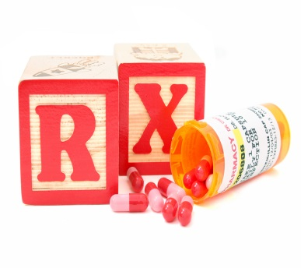
Restless Nights
•Dalmane
•Doral
•Halcion
•ProSom
•Restoril
•Klonopin
•Ativan
•Xanax

Slide 6
Social Unrest

Slide 7
Alcoholism
18 Million Americans are alcoholics

Slide 8
Drug Abuse
23 Million Americans are drug addicted

Slide 9
Unhappy Homes

Slide 10
Frustrated Children

Slide 11
Suicide
Suicide deaths are the leading cause of deaths “by injury;” an increase of 15% in the last ten years

Slide 12
No Peace of Mind
Luminal
Valium

Slide 13
Feelings
of
Guilt

Slide 14
Phobias
(FEAR)

Slide 15
Insecurities
(DOUBT)

Slide 16
Anxieties
(WORRY)

Slide 17
Finding Peace of Mind
No Peace of Mind
FAITH IN GOD (Absolute & Unwavering)
PRAYING ALWAYS (Believing & Trusting)
WORKING IN HIS KINGDOM (Diligently)

