Slide 2
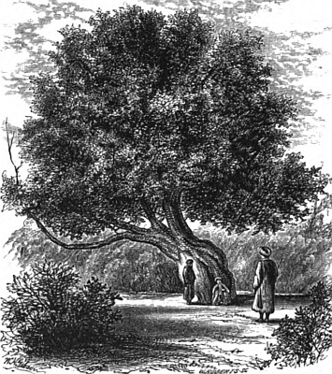
Luke 13:6-9
⁶ He also spoke this parable: A certain man had a fig tree planted in his vineyard, and he came seeking fruit on it and found none. ⁷ Then he said to the
keeper of his vineyard, look, for three years I have come seeking fruit on this fig tree and find none. Cut it down; why does it use up the ground? ⁸ But he answered and said to him, sir, let it alone this year also, until I dig around it and fertilize it. ⁹ And if it bears fruit, well. But if not, after that you can cut it down.

Slide 4
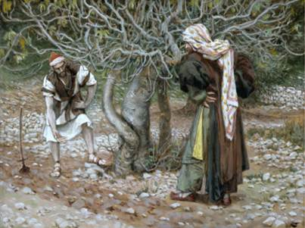
Parable of the Barren Fig Tree
Parable of the Barren Fig Tree
He also spoke this parable: A certain man had a fig tree planted in his vineyard, and he came seeking fruit on it and found none. Then he said to the keeper of his vineyard, look, for three years I have come seeking fruit on this fig tree and find none. Cut it down; why does it use up the ground? But he answered and said to him, sir, let it alone this year also, until I dig around it and fertilize it. And if it bears fruit, well. But if not, after that you can cut it down.

Slide 5
Parable of the Barren Fig Tree
Valuable—bore fruit three times each year (almost 10 months)
Fig trees abundantly found in Promised Land (Deut 8:8).
Symbol of peace, security and prosperity (1 Kings 4:24-25)

Slide 6
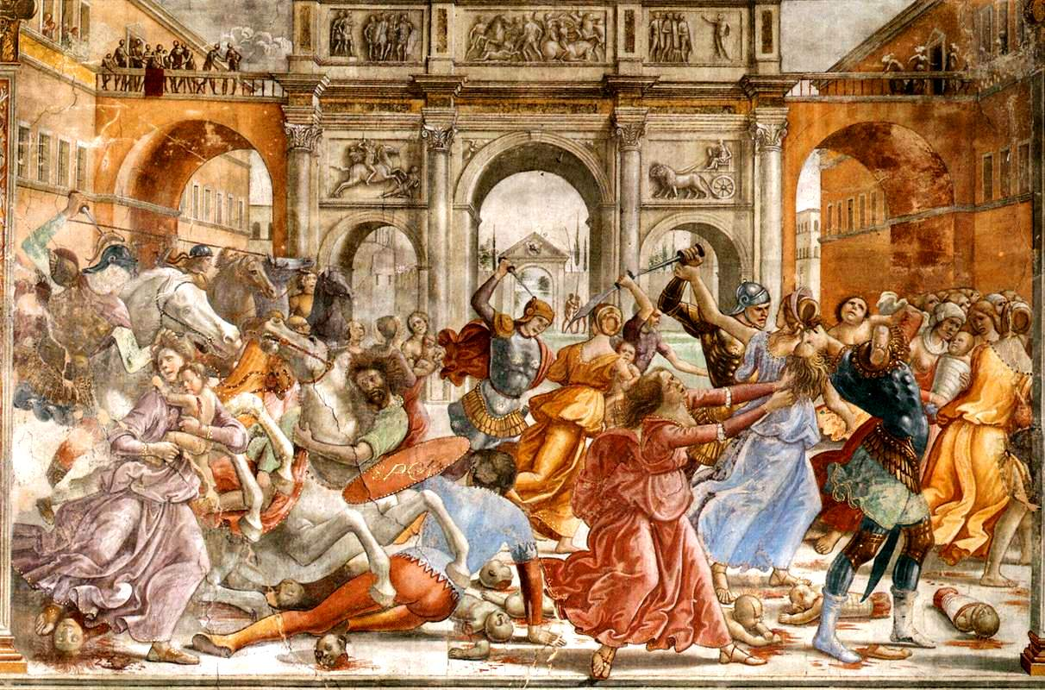
Parable of the Barren Fig Tree
There were present at that season some who told Him about the Galileans whose blood Pilate had mingled with their sacrifices. And Jesus answered and said to them, do you suppose that these Galileans were worse sinners than all other Galileans, because they suffered such things? I tell you, no; but unless you repent you will all likewise perish. Or those eighteen on whom the tower in Siloam fell and killed them, do you think that they were worse sinners than all other men who dwelt in Jerusalem? I tell you, no; but unless you repent you will all likewise perish. (Luke 13:1-5)
There were present at that season some who told Him about the Galileans whose blood Pilate had mingled with their sacrifices. And Jesus answered and said to them, do you suppose that these Galileans were worse sinners than all other Galileans, because they suffered such things? I tell you, no; but unless you repent you will all likewise perish. Or those eighteen on whom the tower in Siloam fell and killed them, do you think that they were worse sinners than all other men who dwelt in Jerusalem? I tell you, no; but unless you repent you will all likewise perish. (Luke 13:1-5)
Repent or Perish
Repent NOW

Slide 7
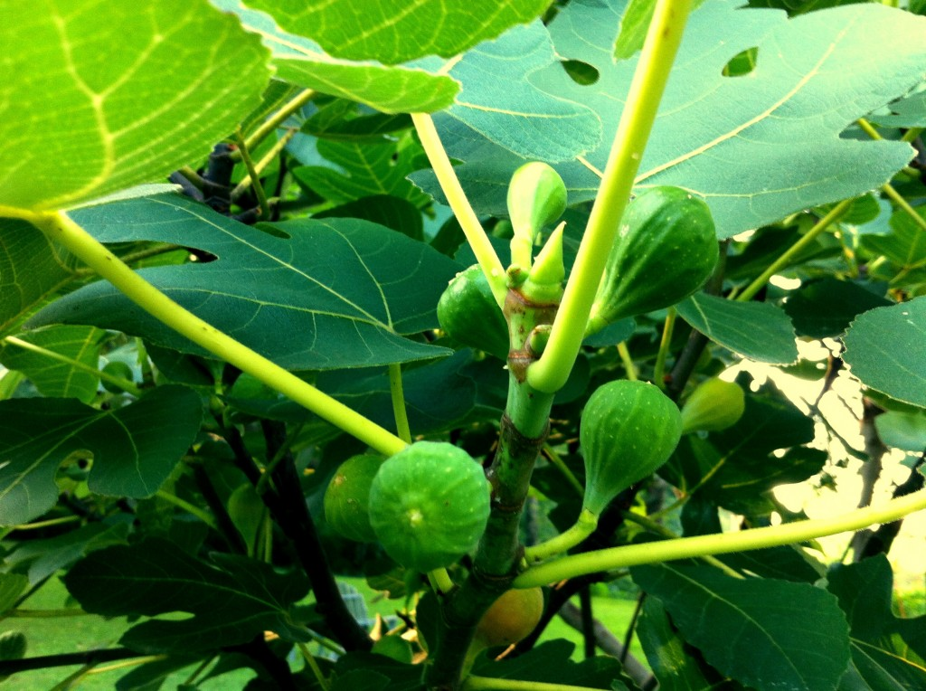
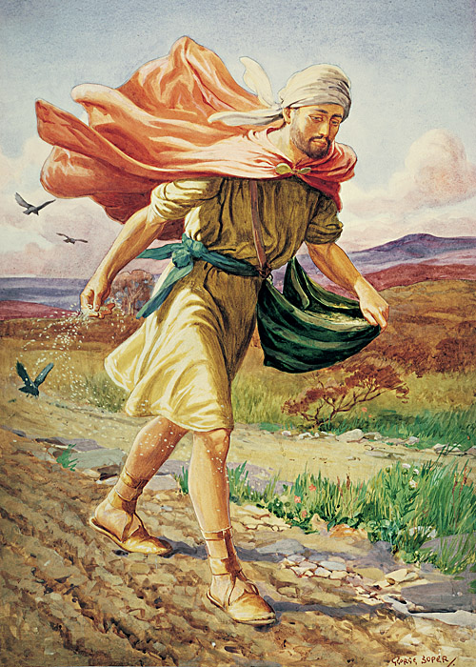
Parable of the Barren Fig Tree
Planted to Produce Fruit
Fruit of Godliness (Rom 6:22; Gal 5:22-23)
Fruit of Service (Col 1:10)
Fruit of Conversions (Prov 11:30; Rom 1:13)

Slide 8
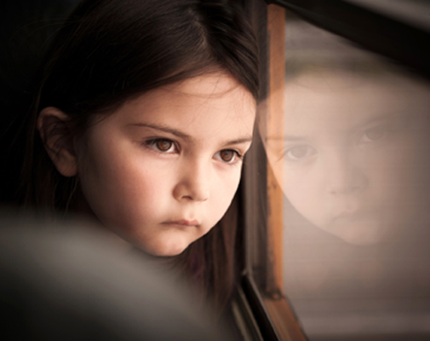
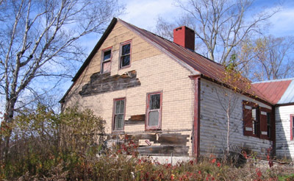
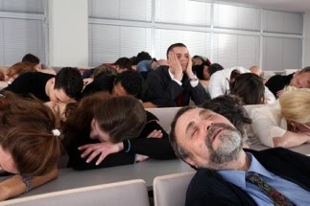
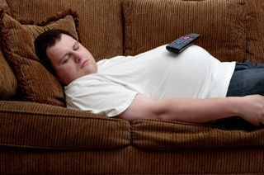
Parable of the Barren Fig Tree
Planted to Produce Fruit
Idleness is not an Option
Children
Churches
Houses
Christians
Nations
Marriages

Slide 9
Parable of the Barren Fig Tree
Planted to Produce Fruit
Idleness is not an Option
Not the Circumstances
Problem was not the ground--it was fruitlessness!

Slide 10
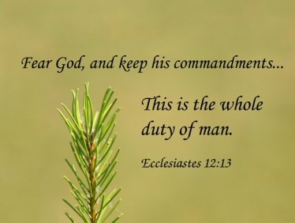
Parable of the Barren Fig Tree
Planted to Produce Fruit
Idleness is not an Option
Not the Circumstances
Time Finally Runs Out

