Slide 2
Acts 24:22-27
²² But when Felix heard these things, having more accurate knowledge of the Way, he adjourned the proceedings and said, when Lysias the commander comes down, I will make a decision on your case. ²³ So he commanded the centurion to keep Paul and to let him have liberty, and told him not to forbid any of his friends to provide for or visit him. ²⁴ And after some days, when Felix came with his wife Drusilla, who was Jewish, he sent for Paul and heard him concerning the faith in Christ. ²⁵ Now as he reasoned about righteousness, self-control, and the judgment to come, Felix was afraid and answered, go away for now; when I have a convenient time I will call for you. ²⁶ Meanwhile he also hoped that money would be given him by Paul, that he might release him. Therefore he sent for him more often and conversed with him. ²⁷ But after two years Porcius Festus succeeded Felix; and Felix, wanting to do the Jews a favor, left Paul bound.

Slide 4
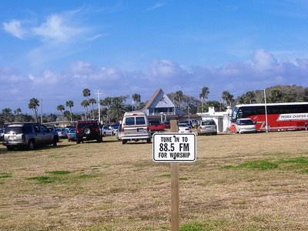
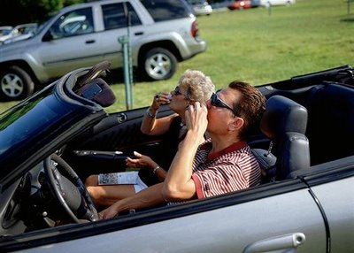
Conveniences
Food cooked on electric/gas stove instead of a wood stove
Milk from a carton instead of milking ole Jersey
Butter from a package instead of a butter churn
Water from a tap instead of a bucket from the spring
Refrigerators, freezers, microwaves, electric can openers, etc.
Bank
Cleaners
Pharmacy
Fast Food
Convenience for the Busy Believer

Slide 5
Antonius Felix
(Procurator of Judea, 53-60 AD)
Josephus [he was cruel, corrupt, covetous and incompetent].
Married three times.
Drusilla
(Felix’s Jewish wife)
Daughter of Herod Agrippa I.
Married at age 14 to Azizus, king of Syria.
Deserted Azizus to marry Felix.
Felix & Drusilla had one son.
Apostle Paul

Slide 6
The Road to Felix
Arrested in the Temple (Ac 21:26-36)
Paul invokes his Roman citizenship and makes a passionate defense (Ac 21:37-22:30)
He divided the Sanhedrin (Ac 23:1-10)
A Plot to kill Paul is uncovered (Ac 23:22)
He is sent to Felix for trial (Ac 23:26-34)
Accusations are made against Paul to Felix (Ac 24:1-9)
Paul makes his defense (Ac 24:10-21)
Felix delays his decision (Ac 24:22-23)

Slide 7
Apostle Paul
Discussing his faith in Christ (vs 24).
Don’t have ALL he said—but we have the essence of his message.
Three major points . . .
Righteousness
Self-Control
Coming Judgment

Slide 8
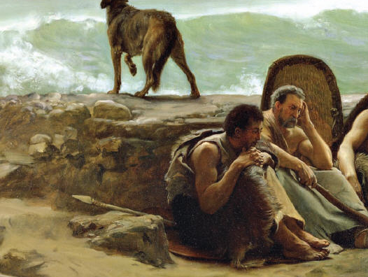
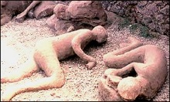
Drusilla & son perished in the
eruption of Mount Vesuvius
Felix: Exiled to Gaul, where he died
. . . deadens the urgency of the message
. . . soothes the fears
. . . diminishes the sin
. . . hardens the heart
. . . produces a convenient religion

Slide 9
Rich Young Ruler never found the time (Matt 19:22)
The Scribe never found the time (Mk 12:34)
King Agrippa never found the time (Ac 26:28)
Felix never found the time (Ac 24:25)
What about YOU? (2 Cor 6:2)

