Slide 2
1 John 5:6-13
⁶ This is He who came by water and blood—Jesus Christ; not only by water, but by water and blood. And it is the Spirit who bears witness, because the Spirit is truth. ⁷ For there are three that bear witness in heaven: the Father, the Word, and the Holy Spirit; and these three are one. ⁸ And there are three that bear witness on earth: the Spirit, the water, and the blood; and these three agree as one. ⁹ If we receive the witness of men, the witness of God is greater; for this is the witness of God which He has testified of His Son. ¹⁰ He who believes in the Son of God has the witness in himself; he who does not believe God has made Him a liar, because he has not believed the testimony that God has given of His Son. ¹¹ And this is the testimony: that God has given us eternal life, and this life is in His Son. ¹² He who has the Son has life; he who does not have the Son of God does not have life. ¹³ These things I have written to you who believe in the name of the Son of God, that you may know that you have eternal life, and that you may continue to believe in the name of the Son of God.

Slide 4
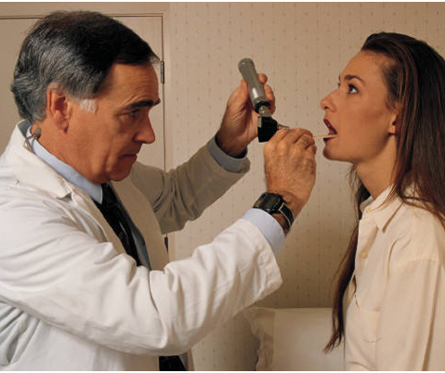
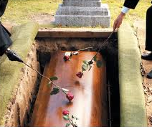
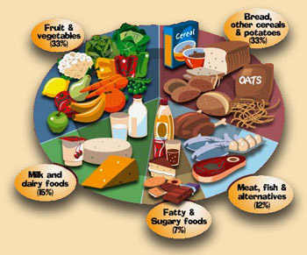
The Fountain of Youth
No Fountain of Youth
Exercise daily, belong to health clubs, take vitamins, drink plenty of water . . .
You can eat a balanced diet three time a day, avoid trans-fats, red meat and fried foods . . .
Spend thousands yearly on: Facial Oils, Skin Creams, Face Lifts & Tummy Tucks . . .
Have yearly checkups, health screenings, and take all prescribed medications . . .
Get eight hours sleep each night and rest throughout the day . . .
“. . .it is appointed for men to die. . .”
(Heb 9:27)

Slide 5
“Most assuredly, I say to you, he who hears my word and believes in Him who sent Me has everlasting life, and shall not come into judgment, but has passed from death into life” (John 5:24).
“Whoever eats My flesh and drinks My blood has eternal life, and I will raise him up at the last day” (John 6:54).
But, Jesus . . .

Slide 6
But, Jesus . . .
“My sheep hear My voice, and I know them, and they follow Me. And I give them eternal life, and they shall never perish; neither shall anyone snatch them out of my hand” (John 10:27-28).

Slide 7
Eternal Life
God desires to share His kind of life (eternal life) with sinful mankind.
“Even from everlasting to everlasting, You are God” (Psalm 90:2).
“God is Love. In this the love of God was manifested toward us, that God has sent His only begotten Son into the world, that we might live through Him” (1 John 4:8-9).
“This is the true God and eternal life” (1 John 5:20).

Slide 8
Can we know we have received eternal life?
NO! We can’t ever be 100% sure—we just do the best we can and perhaps we’ll make it.
Jesus died for us so that we could have a “chance” of receiving eternal life.
“I know my Redeemer lives” has given way to “There is a chance my Redeemer lives.”
“Blessed Assurance” has been replaced with “No assurance at all, just do your best and maybe you will make it.”

Slide 9
“And this is the testimony; that God has given us eternal life, and this life is in His Son. He who does not have the Son of God does not have life. These things I have written to you who believe in the name of the Son of God, that you may know you have eternal life, and that you may continue to believe in the name of the Son of God.”
(1 John 5:11-13)
“Feeling” is not knowing—Genesis 37:31-35
John 8:32
1 Timothy 4:3
Romans 7:7

Slide 10
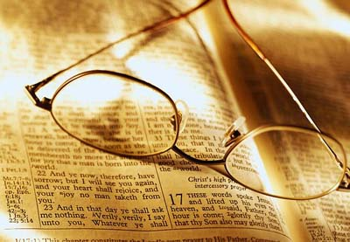
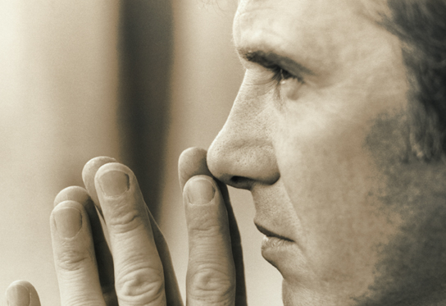
Can we know we have received eternal life?
Jn 4:24
Mk 12:29-30
1 Jn 3:14
Acts 22:16
Acts 2:38
1 Jn 2:15-17
Yes!
ABSOLUTELY NOT!
Knowing you presently possess eternal life does not mean you will PERMINTATLY possess eternal life.
But, if I KNOW I have eternal life now—isn’t that a form of Calvinism (Once Saved Always Saved)?
I have written to you . . . that you may know you have eternal life (1 Jn 5:13).

Slide 11
“I am the resurrection and the life. He who believes in Me, though he may die, he shall live”
(John 11:25)
“And this is the testimony; that God has given us eternal life, and this life is in His Son. He who does not have the Son of God does not have life. These things I have written to you who believe in the name of the Son of God, that you may know you have eternal life, and that you may continue to believe in the name of the Son of God.”
(1 John 5:11-13)
“And this is the testimony; that God has given us eternal life, and this life is in His Son. He who does not have the Son of God does not have life. These things I have written to you who believe in the name of the Son of God, that you may know you have eternal life, and that you may continue to believe in the name of the Son of God.”
(1 John 5:11-13)
“And this is the testimony; that God has given us eternal life, and this life is in His Son. He who does not have the Son of God does not have life. These things I have written to you who believe in the name of the Son of God, that you may know you have eternal life, and that you may continue to believe in the name of the Son of God.”
(1 John 5:11-13)
Six Cities of Refuge
Numbers 35
“For the wages of sin is death, but the gift of God is eternal life in Christ Jesus our Lord” (Romans 6:23)
“My sheep hear My voice . . . and they follow Me. And I give them eternal life . . .”
(John 10:27)

