Slide 2
Genesis 3:20-24
20 And Adam called his wife's name Eve, because she was the mother of all living. 21 Also for Adam and his wife the LORD God made tunics of skin, and clothed them. 22 Then the LORD God said, behold, the man has become like one of Us, to know good and evil. And now, lest he put out his hand and take also of the tree of life, and eat, and live forever—23 therefore the LORD God sent him out of the garden of Eden to till the ground from which he was taken. 24 So He drove out the man; and He placed cherubim at the east of the garden of Eden, and a flaming sword which turned every way, to guard the way to the tree of life.

Slide 4
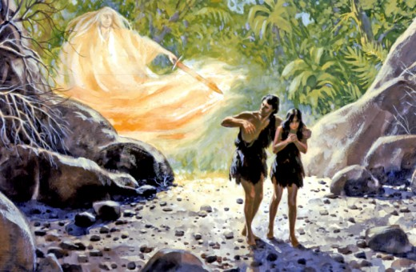

And the LORD God commanded the man, saying, of every tree of the garden you may freely eat; but of the tree of the knowledge of good and evil you shall not eat, for in the day that you eat of it you shall surely die.
(Genesis 2:16-17).
So He drove out the man; and He placed cherubim at the east of the garden of Eden, and a flaming sword which turned every way, to guard the way to the tree of life.
(Genesis 3:24).

Slide 5
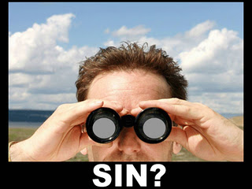
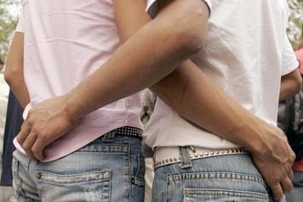

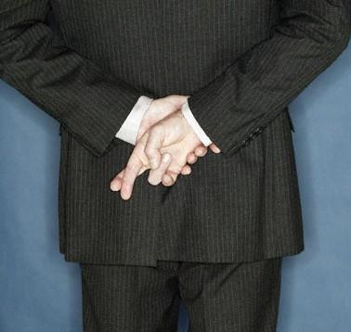
“Exaggerate”
“Shading the Truth”
“Gay”
“Alternate Lifestyle”
“An Affair”
“Playing Around”

Slide 6


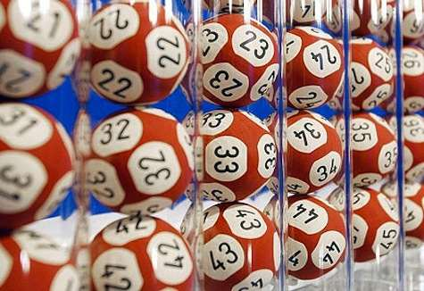
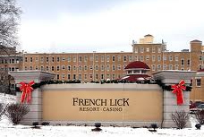
“Gaming”
“Recreation”

Slide 7
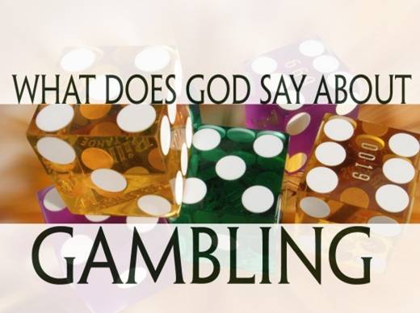
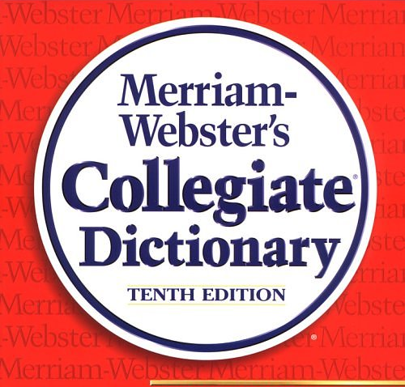

What is Gambling?
Not merely “chance” (Ecclesiastes 9:11)
Farmer planting crops!
Investing in business / stocks!
Driving a car—flying in an airplane!
“The act of risking what is yours in order to get that which belongs to another with nothing given in return.”

Slide 8

What is Gambling?
Betting on the outcome of sporting events
Betting on the fall of the cards
Betting on the alignment of the slots
Betting on the roll of the dice
Betting on the numbers selected in the lottery
Betting on the results of the scratch off
Super Bowl pools / playing golf for $1 per hole

Slide 9

All Gambling is:
It is driven by the Love of Money (Greed)
It is Stealing “by consent”
It encourages poor Stewardship
It disregards the command to Love your Neighbor
It destroys the scriptural “work ethic”

Slide 10


GAMBLING

