Slide 2
Revelation 2:18-29
¹⁸ And to the angel of the church in Thyatira write, these things says the Son of God, who has eyes like a flame of fire, and His feet like fine brass: ¹⁹ I know your works, love, service, faith, and your patience; and as for your works, the last are more than the first. ²⁰ Nevertheless I have a few things against you, because you allow that woman Jezebel, who calls herself a prophetess, to teach and seduce My servants to commit sexual immorality and eat things sacrificed to idols. ²¹ And I gave her time to repent of her sexual immorality, and she did not repent. ²² Indeed I will cast her into a sickbed, and those who commit adultery with her into great tribulation, unless they repent of their deeds. ²³ I will kill her children with death, and all the churches shall know that I am He who searches the minds and hearts. And I will give to each one of you according to your works. ²⁴ Now to you I say, and to the rest in Thyatira, as many as do not have this doctrine, who have not known the depths of Satan, as they say, I will put on you no other burden. ²⁵ But hold fast what you have till I come. ²⁶ And he who overcomes, and keeps My works until the end, to him I will give power over the nations—²⁷ he shall rule them with a rod of iron; they shall be dashed to pieces like the potter’s vessels—as I also have received from My Father; ²⁸ and I will give him the morning star. ²⁹ He who has an ear, let him hear what the Spirit says to the churches.

Slide 4
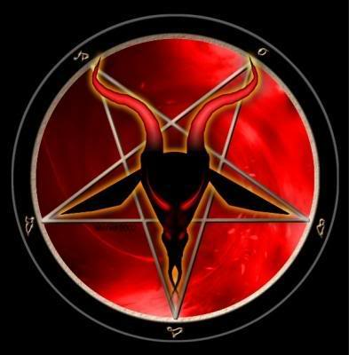
Jezebel
I know your works, love, service, faith, and your patience; and as for your works, the last are more than the first. Nevertheless I have a few things against you, because you allow that woman Jezebel, who calls herself a prophetess, to teach and seduce My servants to commit sexual immorality and eat things sacrificed to idols. (Rev 2:19-20)
Depths of Satan

Slide 5
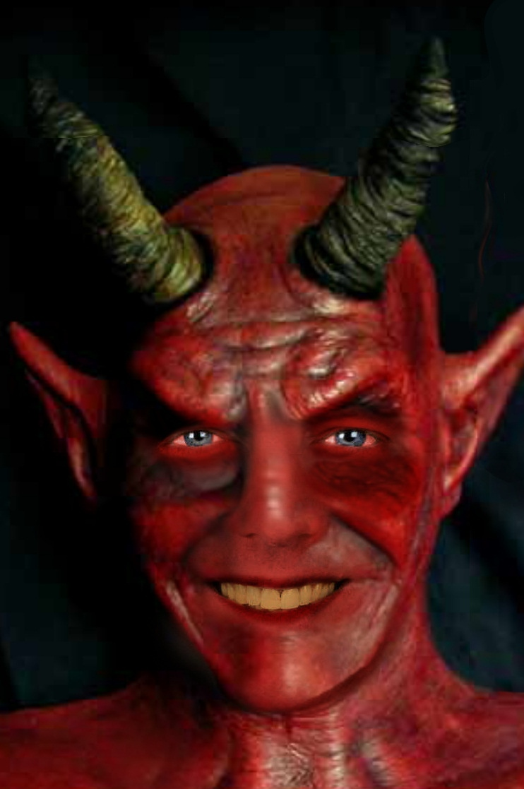
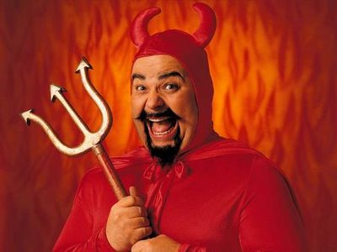
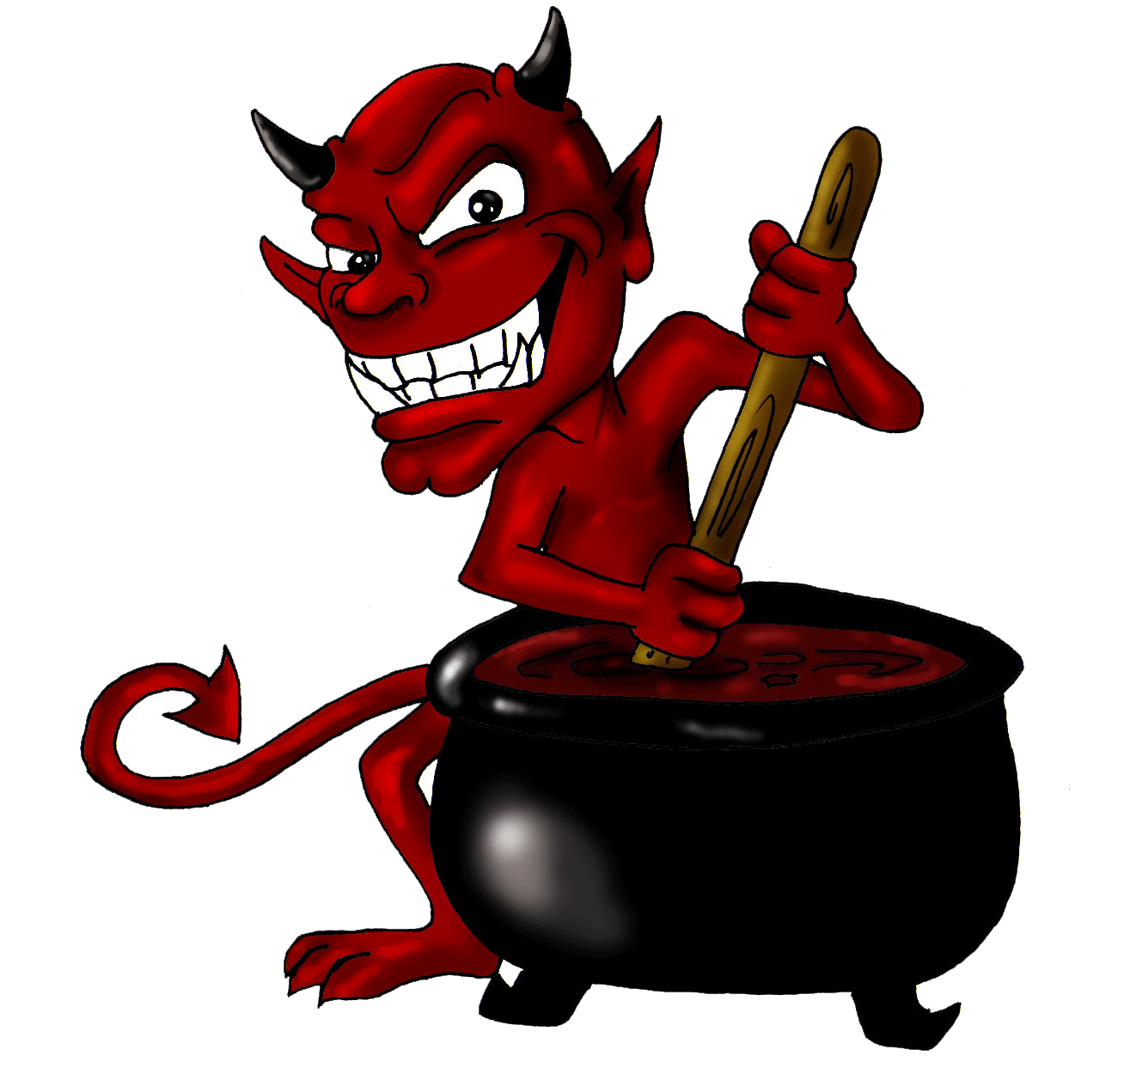
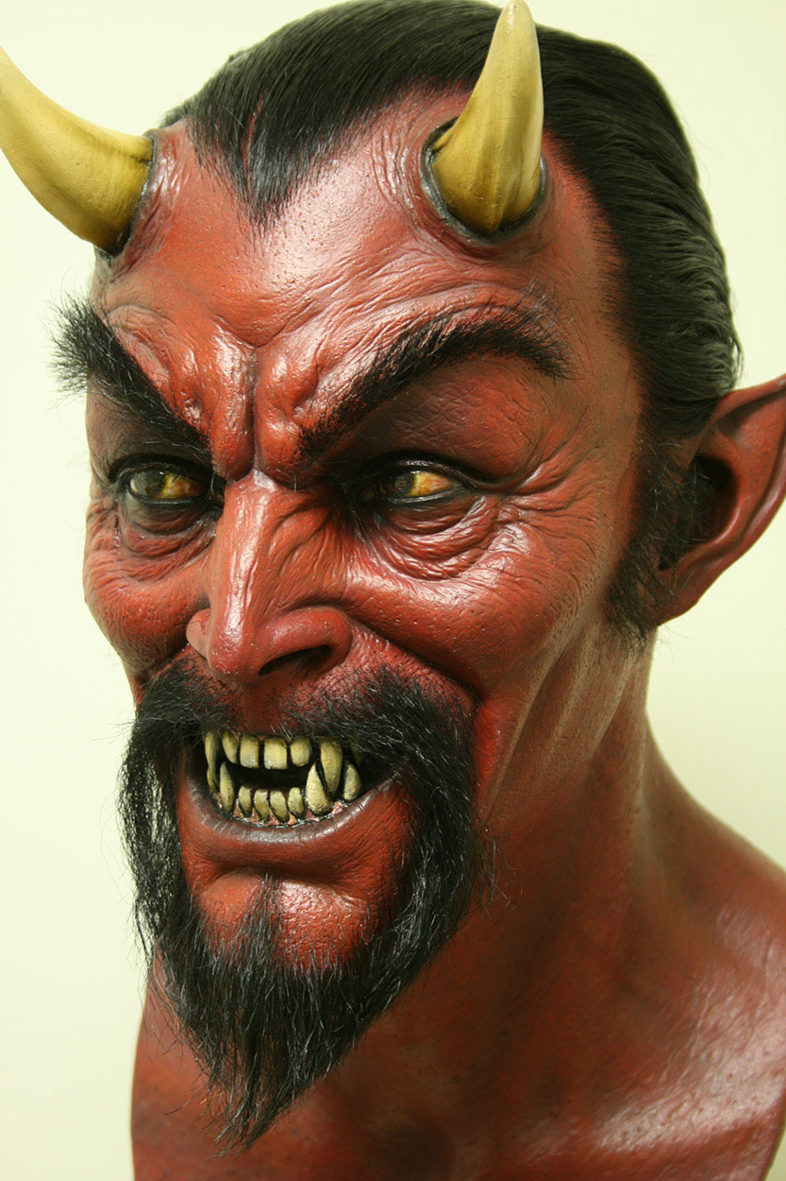
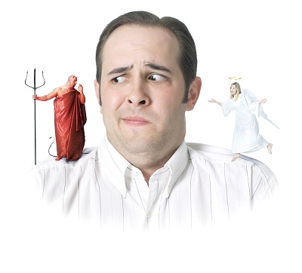
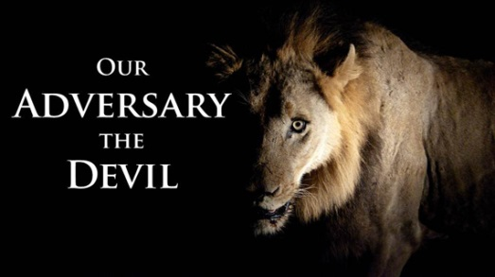
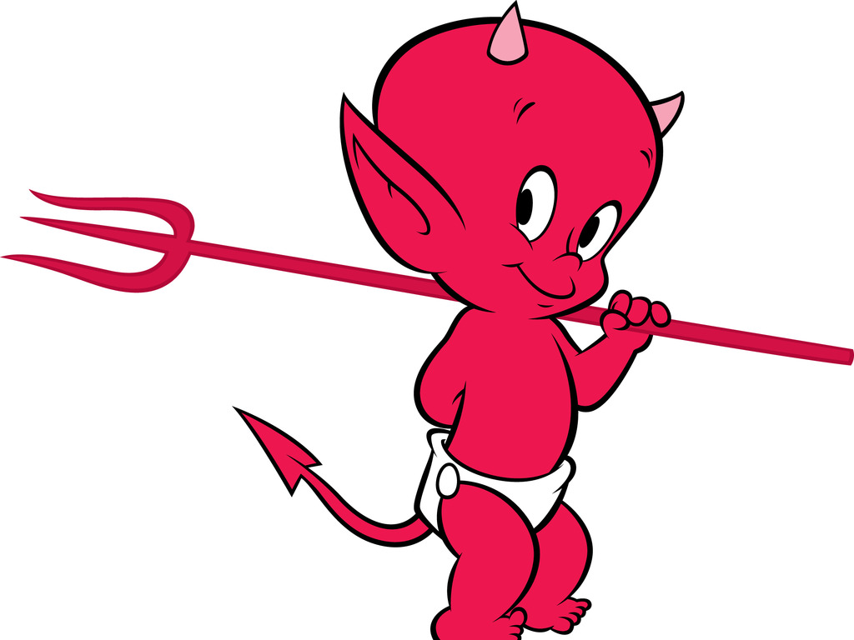
Be sober, be vigilant; because your adversary the devil walks about like a roaring lion, seeking whom he may devour.
(1 Peter 5:8)

Slide 6
Satan Has Power
“. . . the prince of the power of the air, the spirit who now works in the sons of disobedience . . .”
(Eph 2:2).
“ . . . whose minds the god of this age has blinded, who do not believe . . .”
2 Cor 4:4).
“. . . he went to make war with the rest of her offspring, who keep the commandments of God and have the testimony of Jesus Christ . . .”
(Rev 12:17).

Slide 7
Satan Has Wisdom
“. . . the wiles of the devil. For we do not wrestle against flesh and blood, but against principalities, against powers, against the rulers of the darkness of this age, against spiritual hosts of wickedness in the heavenly places.”
(Eph 6:11-12).

Slide 8
Satan Goes where he is Invited
“Then Satan entered Judas, surnamed Iscariot, who was numbered among the twelve. So he went his way and conferred with the chief priests and captains, how he might betray Him to them. And they were glad, and agreed to give him money. So he promised and sought opportunity to betray Him to them in the absence
of the multitude.”
(Luke 22:3-6)

Slide 9
Satan Goes where he is Invited
Satan
“But Peter said, Ananias, why has Satan filled your heart to lie to the Holy Spirit and keep back part of the price of the land for yourself? . . . Then Ananias, hearing these words, fell down and breathed his last. So great fear came upon all those who heard these things.”
(Acts 5:3,5)

Slide 10
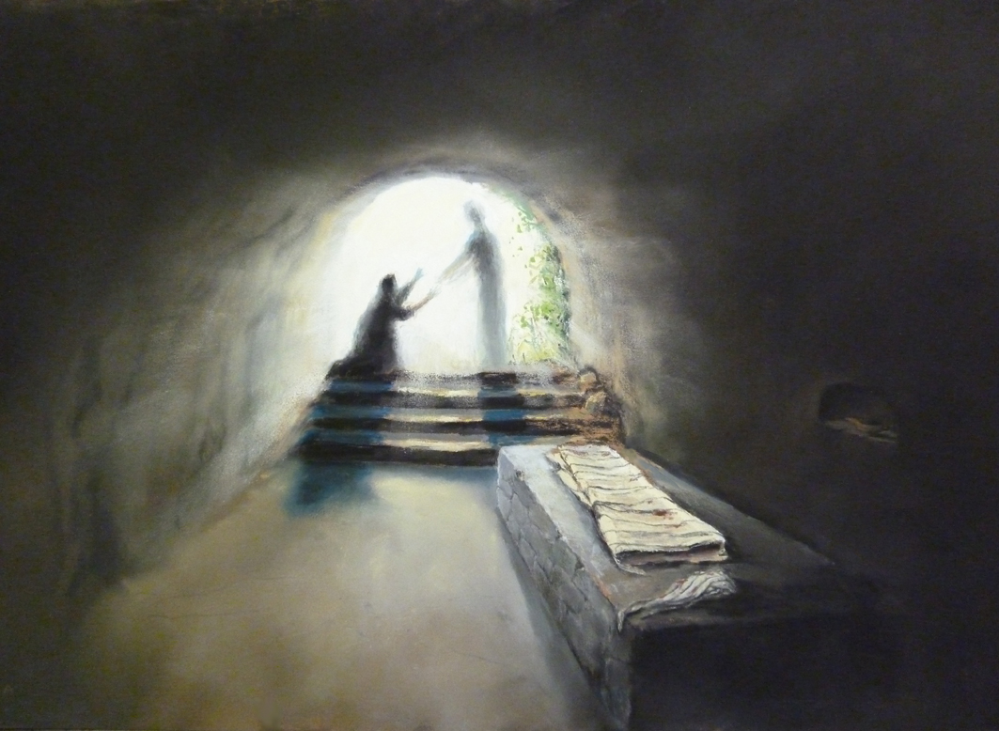
Satan is a defeated Enemy
“And I will put enmity
Between you and the woman,
And between your seed and her Seed; He shall bruise your head, and you shall bruise His heel.”
(Genesis 3:15).
“Therefore submit to God. Resist the devil and he will flee from you. Draw near to God and He will draw near to you.” (James 4:7-8)
“Inasmuch then as the children have partaken of flesh and blood, He Himself likewise shared in the same, that through death He might destroy him who had the power of death, that is, the devil”
(Hebrews 2:14).

