Slide 2
Colossians 1:19-23
¹⁹ For it pleased the Father that in Him all the fullness should dwell, ²⁰ and by Him to reconcile all things to Himself, by Him, whether things on earth or things in heaven, having made peace through the blood of His cross. ²¹ And you, who once were alienated and enemies in your mind by wicked works, yet now He has reconciled ²² in the body of His flesh through death, to present you holy, and blameless, and above reproach in His sight— ²³ if indeed you continue in the faith, grounded and steadfast, and are not moved away from the hope of the gospel which you heard, which was preached to every creature under heaven, of which I, Paul, became a minister.

Slide 4
Mission of the Church

Slide 5
How can we be as
successful in evangelism?
Successful first century
Evangelism!
And He said to them, go into all the world and preach the gospel to every creature (Mark 16:15).
So, as much as is in me, I am ready to preach the gospel to you who are in Rome also (Romans 1:15).
But you shall receive power when the Holy Spirit has come upon you; and you shall be witnesses to Me in Jerusalem, and in all Judea and Samaria, and to the end of the earth (Acts 1:8).
. . . because of the hope which is laid up for you in heaven, of which you heard before in the word of the truth of the gospel, which has come to you, as it has also in all the world . . . (Colossians 1:5-6).
. . . and look, you have filled Jerusalem with your doctrine, (Acts 5:28).
. . . and are not moved away from the hope of the gospel which you heard, which was preached to every creature under heaven . . . (Colossians 1:23).
Therefore those who were scattered went everywhere preaching the word (Acts 8:4).

Slide 6
Love for One Another
Moral Purity
Unity

Slide 7
Preaching
in our Community

Slide 8
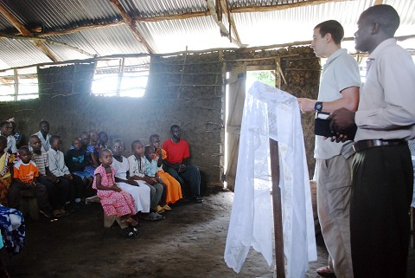

Slide 11
Successful Evangelism
Be men and women of godliness
Be actively teaching in your community
Send men and money to foreign lands
Be generous in giving to have the finances
Be devoted to trusting prayer

