Slide 2
Matthew 18:1-7
¹ At that time the disciples came to Jesus, saying, who then is greatest in the kingdom of heaven? ² Then Jesus called a little child to Him, set him in the midst of them, ³ and said, assuredly, I say to you, unless you are converted and become as little children, you will by no means enter the kingdom of heaven. ⁴ Therefore whoever humbles himself as this little child is the greatest in the kingdom of heaven. ⁵ Whoever receives one little child like this in My name receives Me. ⁶ Whoever causes one of these little ones who believe in Me to sin, it would be better for him if a millstone were hung around his neck, and he were drowned in the depth of the sea. ⁷ Woe to the world because of offenses! For offenses must come, but woe to that man by whom the offense comes!

Slide 4
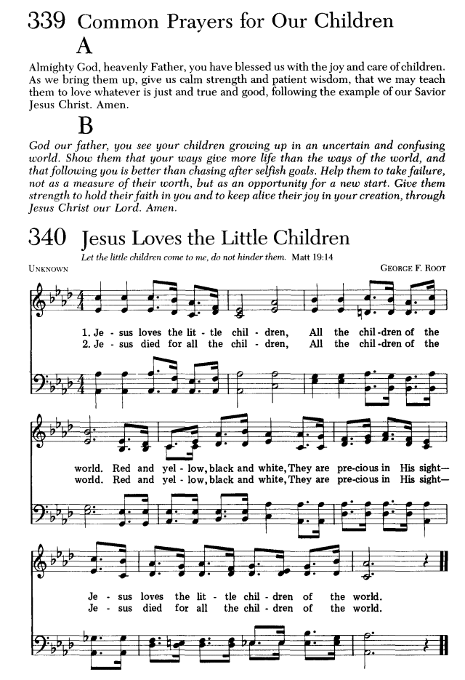
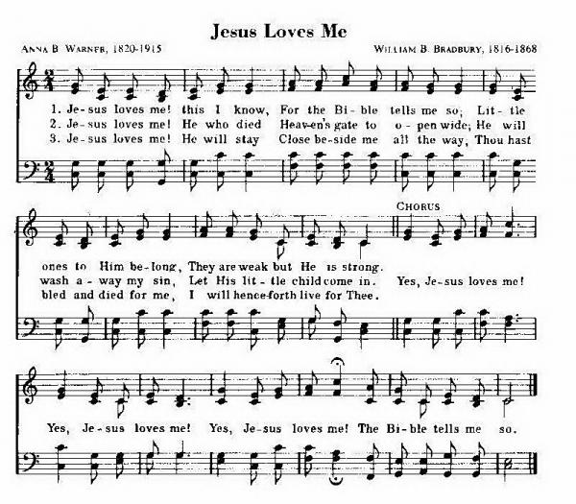

Slide 5
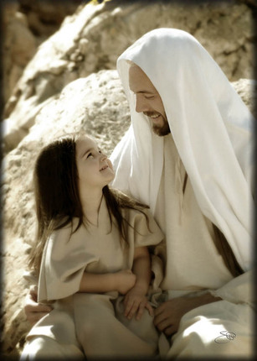
I say to you, unless you are converted and become as little children, you will by no means enter the kingdom of heaven.

Slide 6
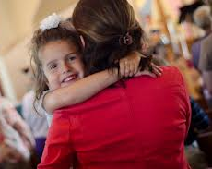
I say to you, unless you are converted and become as little children, you will by no means enter the kingdom of heaven.
Trusting
Obedient
Teachable
Loyal

Slide 7
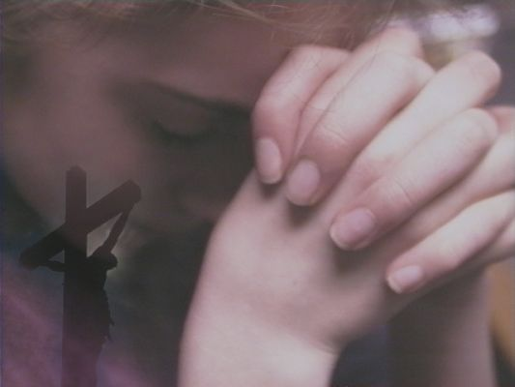
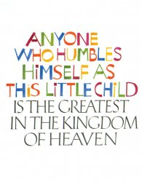
Humility
Becoming poor in Spirit (Matthew 5:3)
Becoming a Servant (Luke 22:26)
Promoting of Others (Philippians 2:3)
Going to the “Back of the Bus” (Luke 14:10)

