Slide 2
1 Timothy 4:12-16
¹² Let no one despise your youth, but be an example to the believers in word, in conduct, in love, in spirit, in faith, in purity. ¹³ Till I come, give attention to reading, to exhortation, to doctrine. ¹⁴ Do not neglect the gift that is in you, which was given to you by prophecy with the laying on of the hands of the eldership. ¹⁵ Meditate on these things; give yourself entirely to them, that your progress may be evident to all. ¹⁶ Take heed to yourself and to the doctrine. Continue in them, for in doing this you will save both yourself and those who hear you.

Slide 4
June 24—28, 2013
7:00—8:30 P.M.
Noble Examples
Joseph
David
Daniel
Jeremiah
Timothy

Slide 5
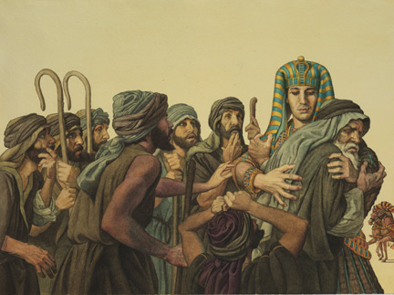
Joseph:
An example in fleeing temptation (Genesis 38:9), and in forgiveness (Genesis 45:4-7)

Slide 6
David:
An example in repentance (Psalm 51:3-4, 13)

Slide 7
Daniel:
An example in commitment (Daniel 1:8)

Slide 8
Jeremiah:
An example of Compassion (Jeremiah 13:17)

Slide 9
Timothy:
An example of Genuine Faith (2 Timothy 1:5)

Slide 10
1 Peter 2:21
Titus 2:7-8

Slide 11
He Went a Little Farther
Then Jesus came with them to a place called Gethsemane, and said to the disciples, sit here while I go and pray over there. And He took with Him Peter and the two sons of Zebedee, and He began to be sorrowful and deeply distressed. Then He said to them, my soul is exceedingly sorrowful, even to death. Stay here and watch with Me. He went a little farther and fell on His face, and prayed, saying, O My Father, if it is possible, let this cup pass from Me; nevertheless, not as I will, but as You will.
Matthew 26:37-39
Nicodemus
(John 3:2-3)
Samaritan Woman
(John 4:6-15)
Paralytic Man
(Mark 2:5)
Jesus’ Death
(Matthew 26:53; John 12:27)

Slide 12
He taught us to go a Little Farther
You have heard that it was said, an eye for an eye and a tooth for a tooth. But I tell you not to resist an evil person. But whoever slaps you on your right cheek, turn the other to him also. If anyone wants to sue you and take away your tunic, let him have your cloak also. And whoever compels you to go one mile, go with him two.
(Matthew 5:38-41)

Slide 13
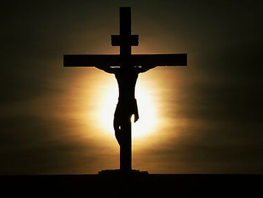
He Went a Little Farther
I gave My life for thee, My precious blood I shed, That thou might'st ransomed be, And quickened from the dead; I gave, I gave My life for thee, What hast thou given for Me? I gave, I gave My life for thee, What hast thou given for Me?
As a Christian Citizen
In My Work of the Lord
In My Worship
As a Christian husband/wife
As a Christian Neighbor
As a Christian at Work
In My Bible Study
As a Peacemaker

