Slide 2
John 5:8-15
⁸ Jesus said to him, rise, take up your bed and walk. ⁹ And immediately the man was made well, took up his bed, and walked. And that day was the Sabbath. ¹⁰ The Jews therefore said to him who was cured, it is the Sabbath; it is not lawful for you to carry your bed. ¹¹ He answered them, He who made me well said to me, take up your bed and walk. ¹² Then they asked him, who is the Man who said to you, take up your bed and walk? ¹³ But the one who was healed did not know who it was, for Jesus had withdrawn, a multitude being in that place. ¹⁴ Afterward Jesus found him in the temple, and said to him, see, you have been made well. Sin no more, lest a worse thing come upon you. ¹⁵ The man departed and told the Jews that it was Jesus who had made him well.

Slide 4
John 5:8-15
⁸ Jesus said to him, rise, take up your bed and walk. ⁹ And immediately the man was made well, took up his bed, and walked. And that day was the Sabbath. ¹⁰ The Jews therefore said to him who was cured, it is the Sabbath; it is not lawful for you to carry your bed. ¹¹ He answered them, He who made me well said to me, take up your bed and walk. ¹² Then they asked him, who is the Man who said to you, take up your bed and walk? ¹³ But the one who was healed did not know who it was, for Jesus had withdrawn, a multitude being in that place. ¹⁴ Afterward Jesus found him in the temple, and said to him, see, you have been made well. Sin no more, lest a worse thing come upon you. ¹⁵ The man departed and told the Jews that it was Jesus who had made him well.

Slide 5
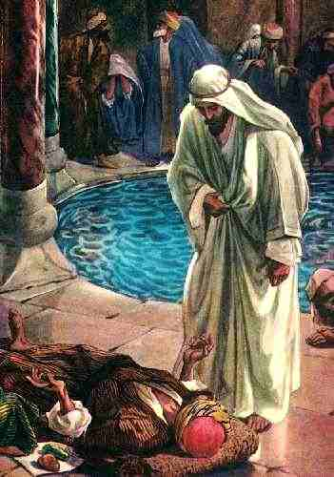
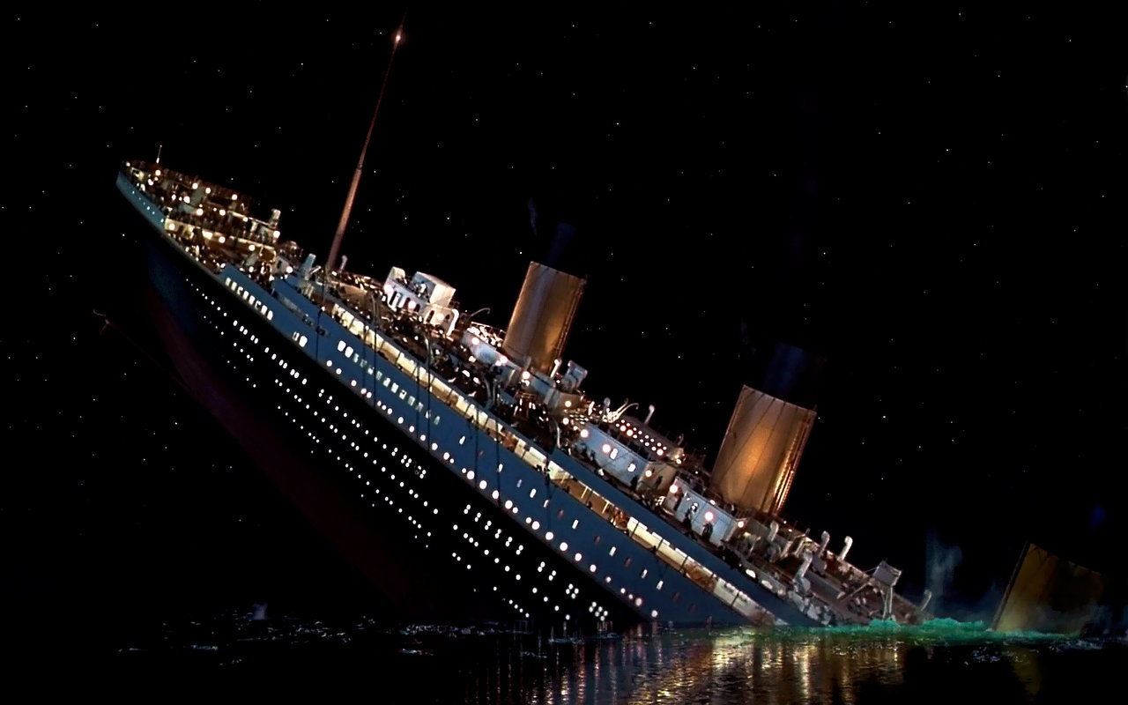
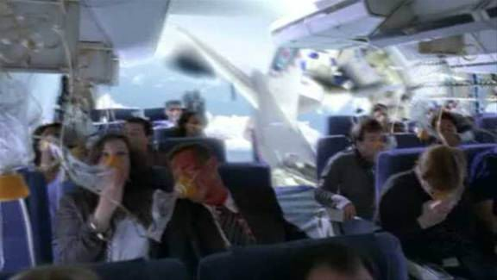
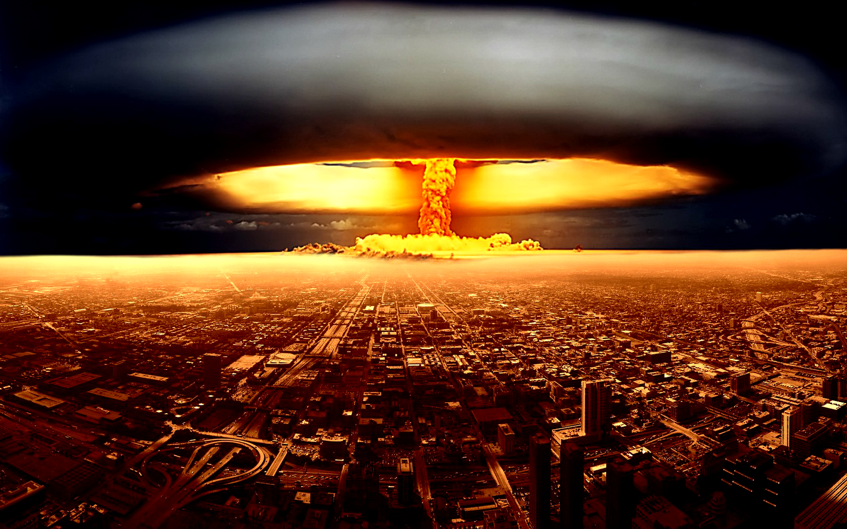
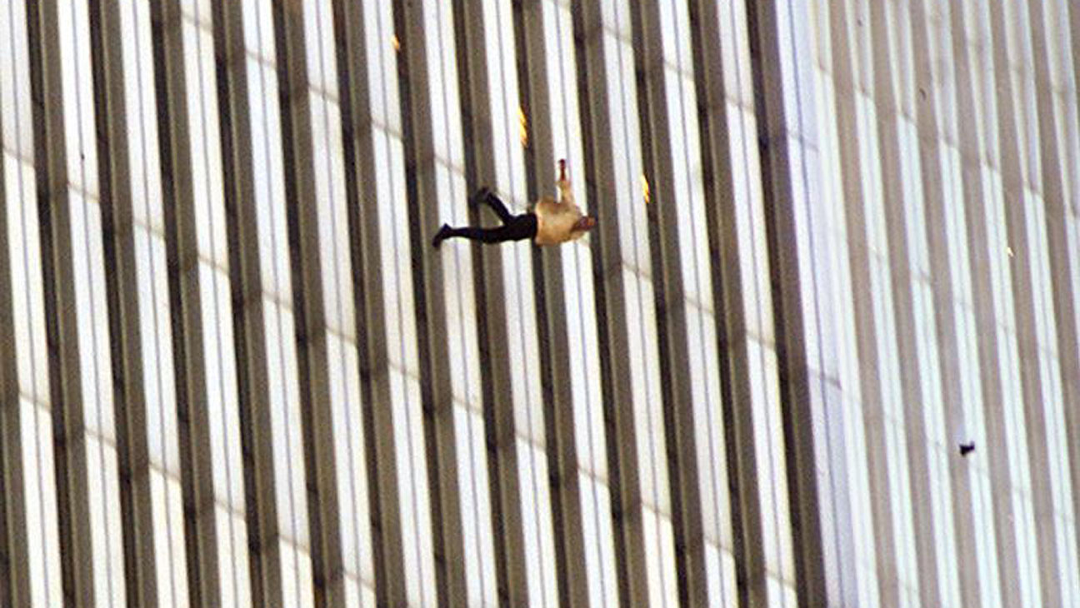
A Worse Thing Can Happen!
What Could Be Worse?
He was Paralyzed for 38 Years
Leprosy ?
Blindness ?
Become a Deaf Mute ?
Paralysis Relapse ?
Something ?
“Sin no more, lest a worse thing come upon you.”

Slide 6
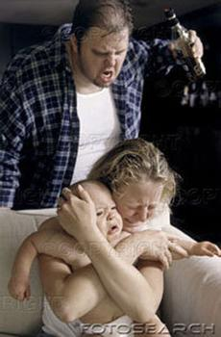
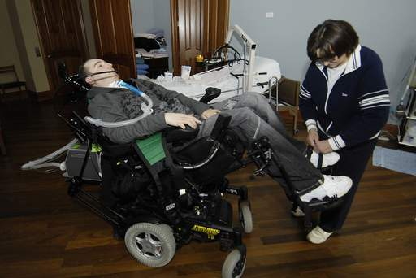
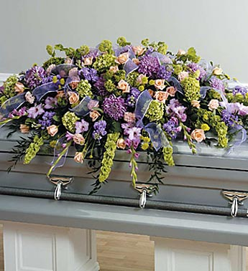
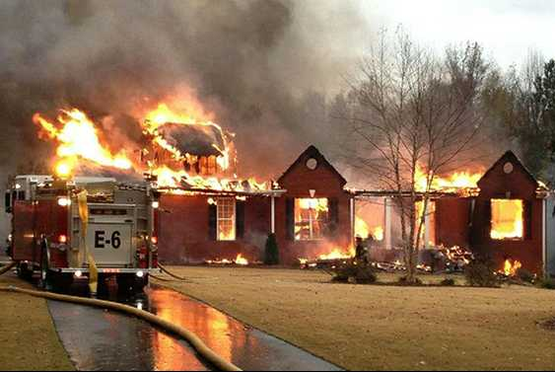
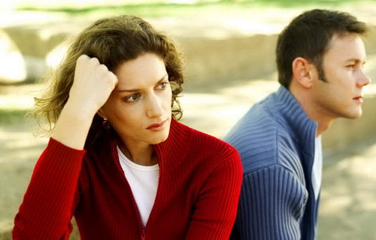
A Worse Thing Can Happen!
What Could Be Worse?
Than Family Tragedies
A Dreadful Illness
Death of a Loved One
Your Death

Slide 7
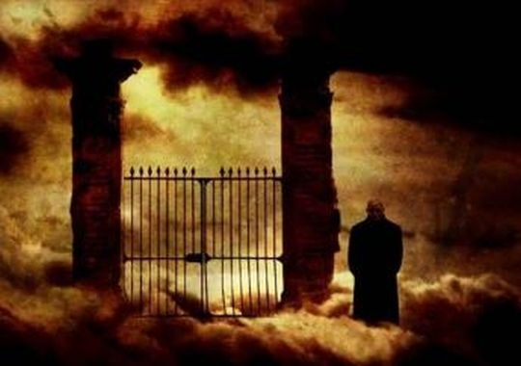
A Worse Thing Can Happen!
Dying in Sin ~ Jn 8:21
What Could Be Worse?
Than Family Tragedies
A Dreadful Illness
Death of a Loved One
Your Death

