Slide 2
Luke 23:26-33
²⁶ Now as they led Him away, they laid hold of a certain man, Simon a Cyrenian, who was coming from the country, and on him they laid the cross that he might bear it after Jesus. ²⁷ And a great multitude of the people followed Him, and women who also mourned and lamented Him. ²⁸ But Jesus, turning to them, said, daughters of Jerusalem, do not weep for Me, but weep for yourselves and for your children. ²⁹ For indeed the days are coming in which they will say, blessed are the barren, wombs that never bore, and breasts which never nursed! ³⁰ Then they will begin to say to the mountains, fall on us! and to the hills, cover us! ³¹ For if they do these things in the green wood, what will be done in the dry? ³² There were also two others, criminals, led with Him to be put to death. ³³ And when they had come to the place called Calvary, there they crucified Him, and the criminals, one on the right hand and the other on the left.

Slide 4
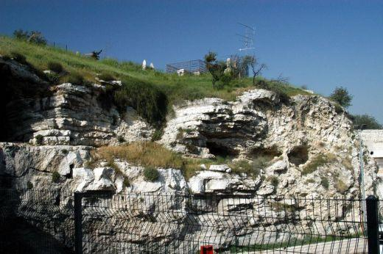
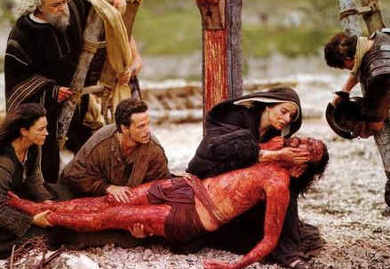
A Place Called Calvary

Slide 5
It’s Because of Calvary
A Place Called Calvary
But God forbid that I should boast except in the cross of our Lord Jesus Christ, by whom the world has been crucified to me, and I to the world (Galatians 6:14).
God so loved the world that He gave His only begotten Son, that whoever believes in Him should not perish but have everlasting life (John 3:16).
In this is love, not that we loved God, but that He loved us and sent His Son to be the propitiation for our sins (1 John 4:10).
Greater love has no one than this, than to lay down one’s life for his friends (John 15:13).
But God demonstrates His own love toward us, in that while we were still sinners, Christ died for us (Romans 5:8).
I have been crucified with Christ; it is no longer I who live, but Christ lives in me; and the life which I now live in the flesh I live by faith in the Son of God, who loved me and gave Himself for me (Galatians 2:20).
That Christ Now Lives in Me
I’m Not the One I Used to Be
I Don’t Do What I Used to Do

