Slide 2
John 18:1-14
¹ When Jesus had spoken these words, He went out with His disciples over the Brook Kidron, where there was a garden, which He and His disciples entered. ² And Judas, who betrayed Him, also knew the place; for Jesus often met there with His disciples. ³ Then Judas, having received a detachment of troops, and officers from the chief priests and Pharisees, came there with lanterns, torches, and weapons. ⁴ Jesus therefore, knowing all things that would come upon Him, went forward and said to them, whom are you seeking? ⁵ They answered Him, Jesus of Nazareth. Jesus said to them, I am He. And Judas, who betrayed Him, also stood with them.

Slide 3
John 18:1-14
⁶ Now when He said to them, I am He, they drew back and fell to the ground. ⁷ Then He asked them again, whom are you seeking? And they said, Jesus of Nazareth. ⁸ Jesus answered, I have told you that I am He. Therefore, if you seek Me, let these go their way, ⁹ that the saying might be fulfilled which He spoke, of those whom You gave Me I have lost none. ¹⁰ Then Simon Peter, having a sword, drew it and struck the high priest’s servant, and cut off his right ear. The servant’s name was Malchus. ¹¹ So Jesus said to Peter, put your sword into the sheath. Shall I not drink the cup which My Father has given Me? ¹² Then the detachment of troops and the captain and the officers of the Jews arrested Jesus and bound Him.

Slide 4
John 18:1-14
¹³ And they led Him away to Annas first, for he was the father-in-law of Caiaphas who was high priest that year. ¹⁴ Now it was Caiaphas who advised the Jews that it was expedient that one man should die for the people.

Slide 6
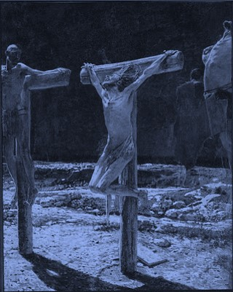
Absurdity of the Cross
For the message of the cross is foolishness to those who are perishing, but to us who are being saved it is the power of God.
(1 Corinthians 1:18)

Slide 7
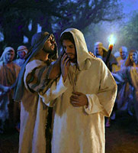
Treachery of Judas

Slide 8
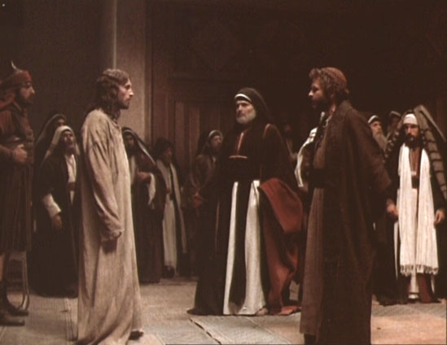
Jesus faces the Sanhedrin Council
“And they led Him away to Annas first, for he was the father-in-law of Caiaphas who was the high priest that year” (John 18:13).
“And those who had laid hold of Jesus led him away to Caiaphas the high priest, where the scribes and the elders were assembled” (Matthew 26:57).

Slide 9
Jesus faces the Sanhedrin Council
Greedy Opportunists
Morally/Legally Corrupt
Exceptionally Religious
“And they led Him away to Annas first, for he was the father-in-law of Caiaphas who was the high priest that year” (John 18:13
“And those who had laid hold of Jesus led him away to Caiaphas the high priest, where the scribes and the elders were assembled” (Matthew 26:57).

Slide 10
Prohibited all judicial proceedings at night,
No investigation by a sole judge,
No accused man is to be subjected to private of secret examination: “lest in his perplexity he furnished damaging testimony against himself.

